Slide 1
Big Data Analytics 2023 Module 6.2 Big Data Applications
Mining Social Network Graphs

Slide 2
Overview
Social Networks as Graphs
Types of Social Network Graphs
Clustering of Social Network Graphs - Girvan newman method
Direct Discovery of Communities- CPM method

Slide 3
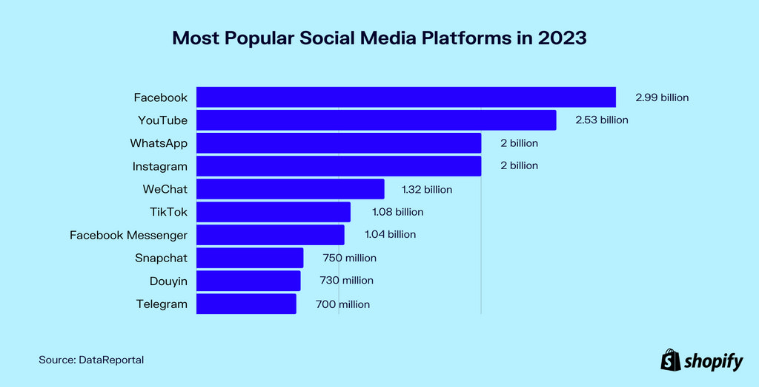

Slide 4
Social Networks - Big Data
Facebook, MySpace, Twitter, Linked-in, Instagram Quora etc.
Data from these networks increases in volumes at every instant in time.
Facebook has over one billion active users with thousands of new users added every day.
Number of interactions added everyday amount to millions.
Interactions using different media like voice, images and even videos.
Thus social network data is "Big Data".

Slide 5
Social Networks - Definition
"A social structure made of nodes that are generally individuals or organizations".
A social network represents relationships and flows between people, groups, organizations, computers or other information/knowledge processing entities.
The term "Social Network" was coined in 1954 by J. A. Barnes.
Examples of social networks include FaceBook, LinkedIn, X, Reddit Instagram, Pinterest etc.

Slide 6
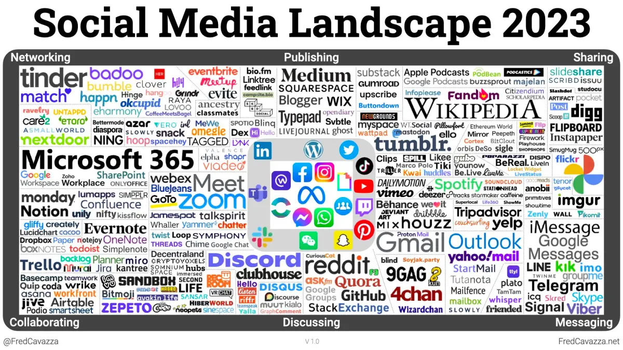

Slide 7
Social Media: Examples
A wiki article
Web reviews and ratings of a popular pizza place in your city
E.g., Yelp.com
An online social network of your professional contacts
E.g., Facebook.com, LinkedIn.com
An iPhone application that informs you where parking is likely available
FasPark
Etc etc

Slide 9
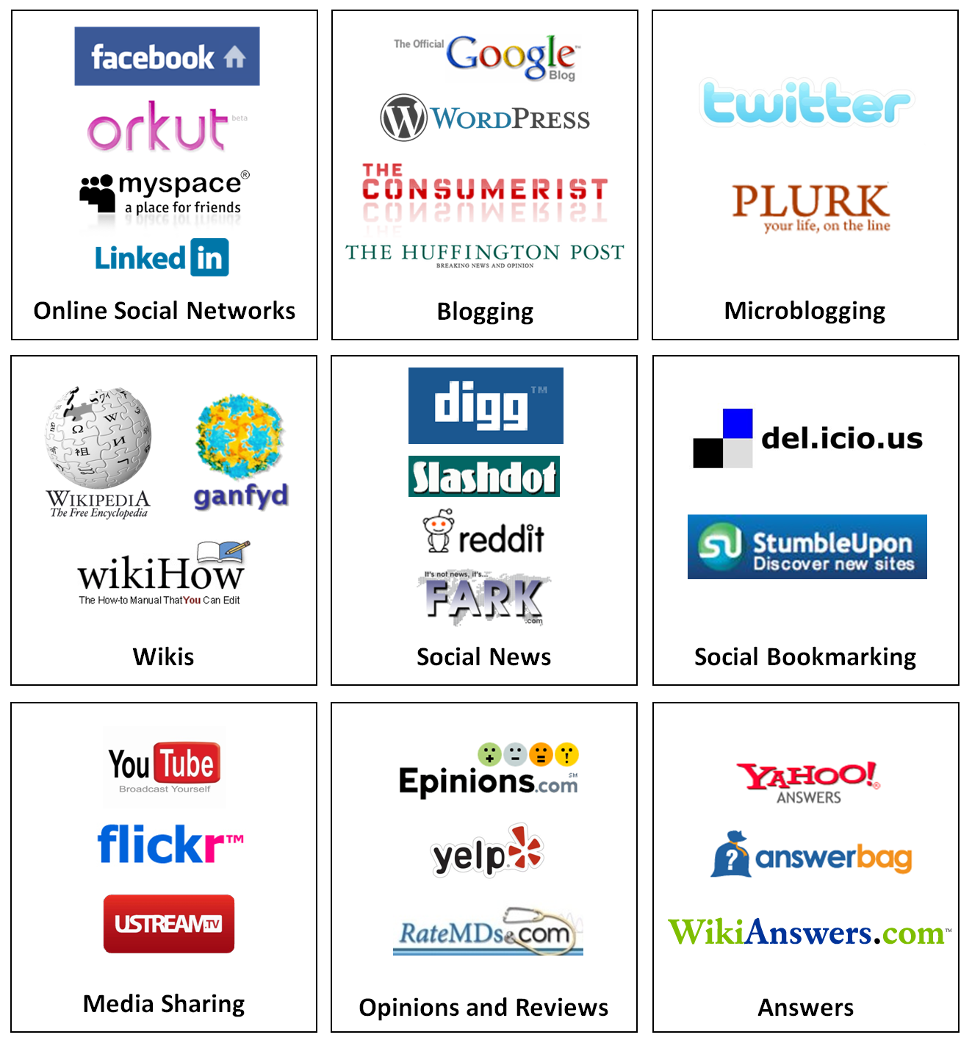
Types of Social Media
Online Social Networking
Publishing
Blogging
Wiki
Micro blogging
Social News
Social Bookmarking
Media Sharing
Video Sharing
Photo Sharing
Podcast Sharing
Opinion, Review, and Ratings Websites
Answers
Entertainment

Slide 10
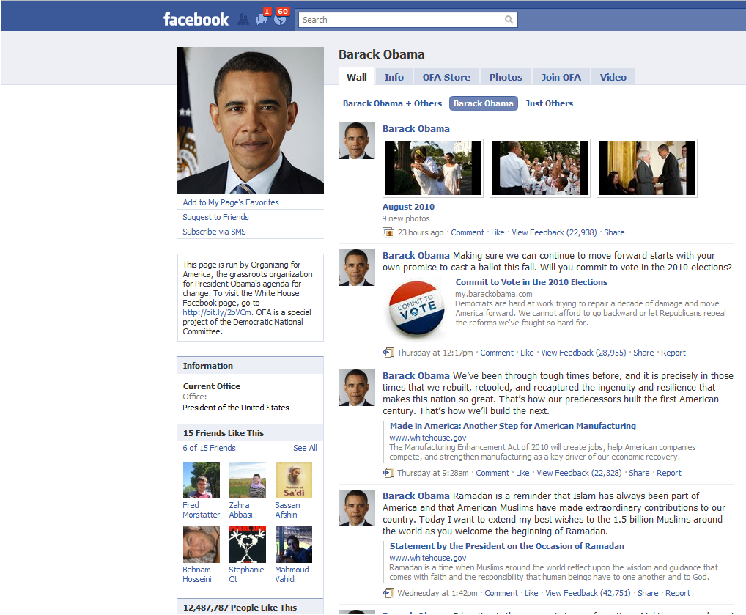
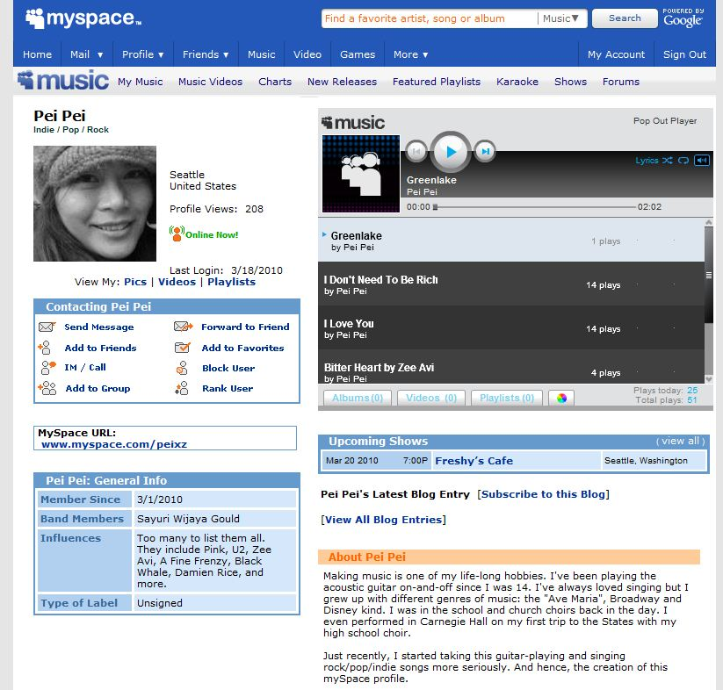
Online Social Networking
Online Social Networks are web-based services that allow individuals and communities to connect with real world friends and acquaintances online
Interactions
Friendship interaction
Friends, like, comments, …
Media Sharing
Sending and receiving messages
Examples
Facebook.com
MySpace.com
Orkut.com

Slide 11

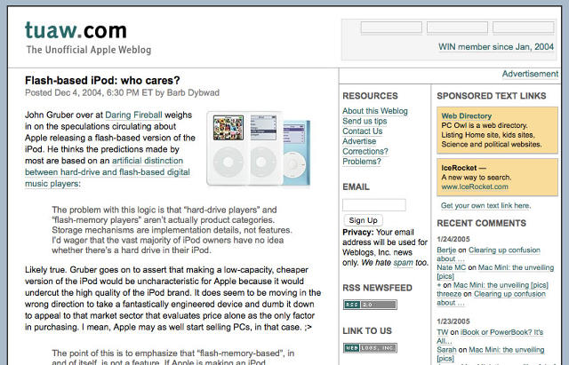
Blogging
A blog is a journal-like website for users, a.k.a. bloggers, to contribute textual and multimedia content, arranged in reverse chronological order
Maintained both individually or by a community
See a tutorial at KDD http://videolectures.net/kdd08_liu_briat/
Usages:
Sharing information and opinions with friends and strangers
Disseminating subject-specific content
Who is the influential http://videolectures.net/wsdm08_agarwal_iib/

Slide 12
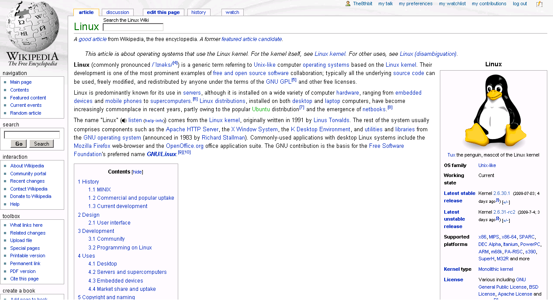
Wiki
A wiki is a collaborative editing environment that allows users to develop Web pages using a simplified markup language
Wikipedia allows interested individuals to collaboratively develop articles on a variety of subjects.
Using the wisdom of crowds effectively, it has become a comprehensive repository of information useful to a variety of individuals

Slide 13
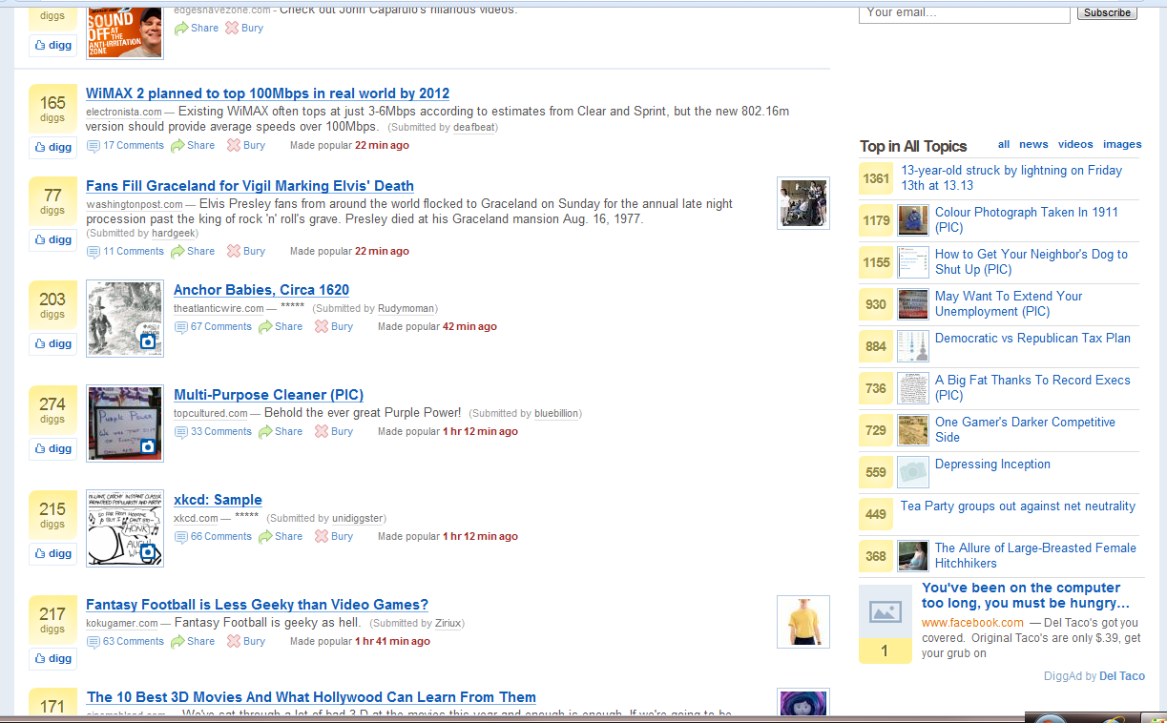
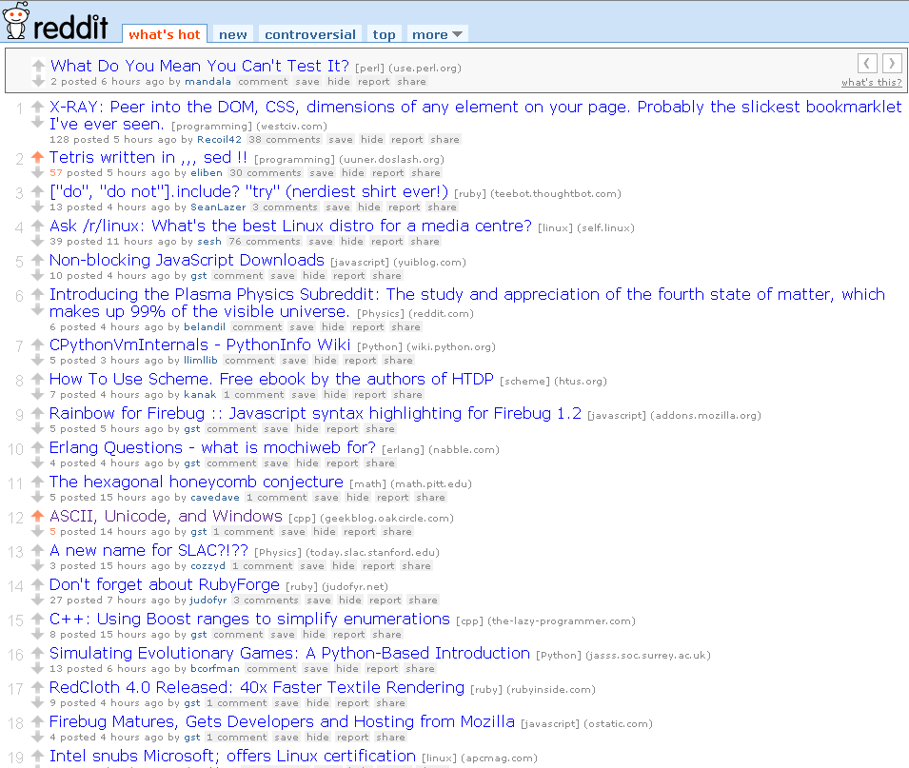
Social News
Social News refers to the sharing and selection of news stories and articles by a community of users.
Users can share articles that they believe would interest the community
Samples:
Mashable
BLOOMBERG
FORBES
Buzzfeed
Reddit

Slide 14
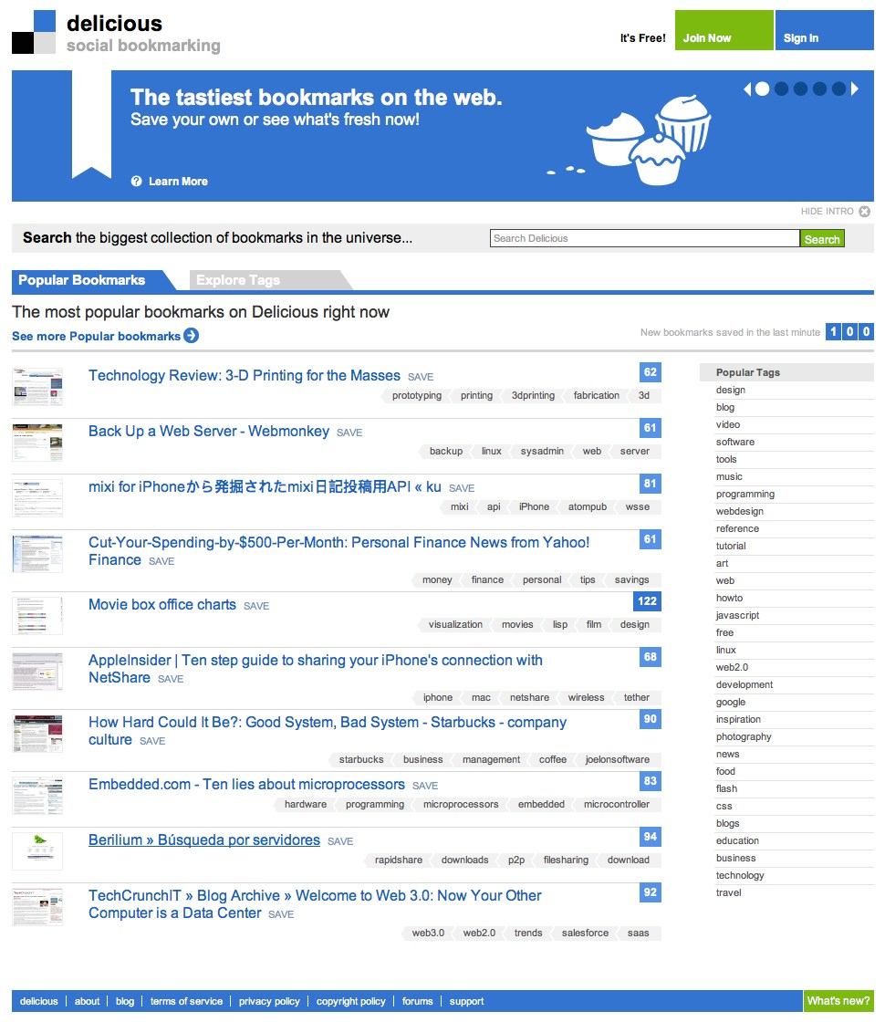
Social Bookmarking
Social Bookmarking sites allow users to bookmark web content for storage, organization and sharing.
These bookmarks can be tagged with metadata to categorize and provide context to the shared content, allowing users to organize information making it easy to search and identify relevant information.
Samples
X
Pinterest
Linktree

Slide 15
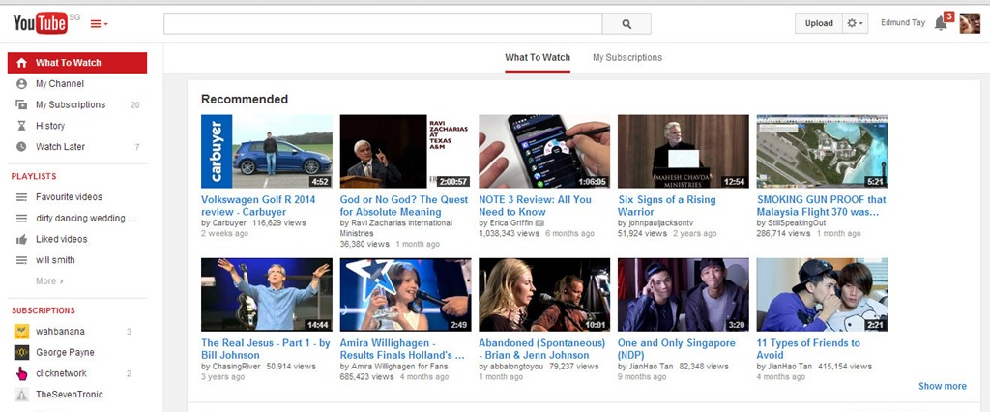
Media Sharing
Media sharing is an umbrella term that refers to the sharing of a variety of media on the web.
Users share such multimedia content of possible interest to others
Samples:
Video Sharing:
YouTube.com
Photo Sharing:
Flickr.com, picasa.com
Document Sharing:
Scribd.com, Slideshare.com
Livecasting:
Justin.tv, Ustream.com

Slide 16
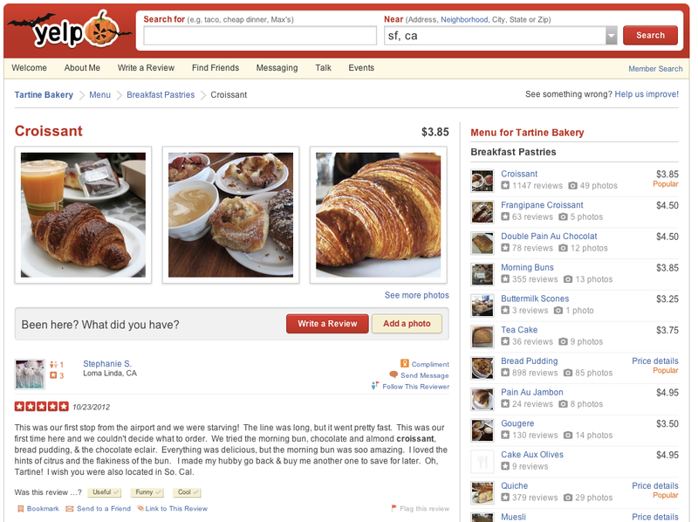
Opinion, Review, and Ratings Websites
Opinion, review, and ratings websites are websites whose primary function is to collect and publish user-submitted content in the form of subjective commentary on existing products, services, entertainment, businesses, places, etc. Some commercial sites may serve a secondary purpose as review sites by publishing product reviews submitted by customers.
Examples
Cnet.com
Epinions.com
yelp.com
tripadvisor.com

Slide 17
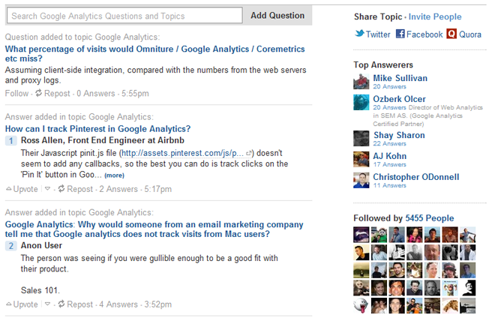
Socially-Provided Answers
In these sites, users who require certain guidance, advice or knowledge can ask questions. Other users from the community can answer these questions based on knowledge acquired from previous experiences, personal opinions or from relevant research.
Unlike review and opinion sites, which contain self-motivated contribution of opinions, answer sites contain knowledge shared in response to a specific query.
Samples:
WikiAnswers, Yahoo Answers, Quora

Slide 18
Main Characteristics
Participation
social media encourages contributions and feedback from everyone who is interested. It blurs the line between media and audience.
Openness
most social media services are open to feedback and participation. They encourage voting, comments and the sharing of information. There are rarely any barriers to accessing and making use of content – password-protected content is frowned on.
Conversation
whereas traditional media is about “broadcast” (content transmitted or distributed to an audience) social media is better seen as a two-way conversation.
Community
social media allows communities to form quickly and communicate effectively. Communities share common interests, such as a love of photography, a political issue or a favorite TV show.
Connectedness
Most kinds of social media thrive on their connectedness, making use of links to other sites, resources and people.

Slide 19
Some Mining Applications
Community Detection
Prediction of next Viral piece of news
Identifying Influential users
Churn prediction

Slide 20
Social Network Mining Applications
Viral marketing
Explores how individuals can influence the buying behavior of others.
Aims to optimize the positive word-of-mouth effect among customers.
Identify strong communities and influential nodes.
Spend more money marketing to an individual if that person has many social connections.
E-Commerce
Grouping together of customers with similar buying profiles enables more personalized recommendation engines.
Community discovery in mobile ad-hoc networks can enable efficient message routing and posting.

Slide 22
FaceBook
The world’s most popular social media network with more than two billion monthly active users worldwide,
Facebook stores enormous amounts of user data, making it a massive data wonderland.
It is estimated that there will be more than 200million Facebook users in the United States alone by 2020.
Facebook is the fifth most valuable public company in the world, with a market value of approximately $321 billion.

Slide 23
FaceBook
Every day, we feed Facebook’s data beast with mounds of information. Every 60 seconds,
136,000 photos are uploaded, 510,000 comments are posted, and 293,000 status updates are posted. That is a LOT of data.
At first, this information may not seem to mean very much. But with data like this, Facebook knows who our friends are, what we look like, where we are, what we are doing, our likes, our dislikes, and so much more.
Some researchers even say Facebook has enough data to know us better than our families, friends and even therapists!

Slide 24
FaceBook
The more users who use Facebook, the more information they amass.
Apart from analyzing user data, Facebook has other ways of determining user behavior.
Tracking cookies:
Facial recognition:
Tag suggestions:
Analyzing the Likes: A recent study conducted showed that is viable to predict data accurately on a range of personal attributes that are highly sensitive just by analyzing a user’s Facebook Likes. Work conducted by researchers at Cambridge University and – work satisfaction, intelligence, emotional stability, religion,and political views—among many others.

Slide 25
Topic Data
Topic Data is a Facebook technology that displays to marketers the responses of the audience with regard to brands, events, activities, and subjects, in a way that keeps their personal information private.
Marketers use the information from topic data to selectively change the way they market on the platform as well as other channels.

Slide 26
The Flashback
Honoring its 10th anniversary, Facebook offered its users the option of viewing and sharing a video that traces the course of their social network activity from the date of registration till the present. Called the “Flashback,” this video is a collection of photos and posts that received the most comments and likes and set to a nostalgic background music.
Other videos have been created since then, including those you can view and share to celebrate a “Friendversary,” the anniversary of two people becoming friends on Facebook. You’ll also be able to see a special video on your birthday.

Slide 27
Other Applications
Personalization
Targeted marketing
Community Analysis
Sentiment Analysis and Opinion Mining
Social Recommendation
Influence Modeling
User attribute and behavior analysis
Location-based interaction analysis

Slide 28
New Application areas 2023
Audience analytics
Performance analytics
Competitive analytics
Paid social media analytics
Customer service and community management analytics
Influencer analytics
Sentiment analysis of your profiles and ad campaigns
Sentiment analysis for customer service

Slide 29
Social Networks - Characteristics
Nodes are typically people; companies, documents, computers etc.
A heterogeneous and multirelational data set represented by a graph.
Both nodes and edges can have attributes.
Objects may have class labels.
Min. one relationship between entities
Facebook connect entities through a relationship called friends.
LInkedIn "endorse" where people can endorse other people for their skills.
Reddit - upvote, downvote

Slide 30
Characteristics
Relationship need not be yes or no; can have a degree.
LinkedIn, we can have a degree of endorsement of a skill like say novice, expert etc.
Degree can also be a real number.
social networks exhibit the property of nonrandomness often called locality.
Locality is the property of social networks that says nodes and edges of the graph tend to cluster in communities.
The intuition is that relationships tend to cluster.
If entity A is related to both B and C, then there is a higher probability than average that B and C are related.
The idea is most relationships in the real worlds rend to cluster around a small set of individuals.

Slide 31
Social Network as a Graph
A natural representation of social network data is to view its structure as a graph.
Entities are converted to nodes in the graph.
Nodes can be of different types—e.g., people, organizations, and events.
Edges in the graph correspond to relations between entities.
If a degree associated with the relationship, represented by labeling the edges.
Edges can be one-directional, bi directional and need not be binary.

Slide 32
Follows Relationship in Twitter
Jack
Kris
Pete
Mary
Bob
Alex
Eve
Tim

Slide 33
LiveJournal – Undirected Edges
Stan
Brin
Pete
Mark
Bob
Irene

Slide 34
DBLP- Weighted Edges
Tan
2
2
1
Liu
Ping
Mark
3
Han
2
1
Kumar

Slide 35
Types of Social Networks -Collaboration Graph
Display interactions
Co-authorships among scientists, co-appearance in movies by actors and actresses
Wikipedia collaboration graph (connecting two Wikipedia editors if they’ve ever edited the same article
"NBA graph" whose vertices are players where two players are joined by an edge if they have ever played together on the same team.

Slide 36
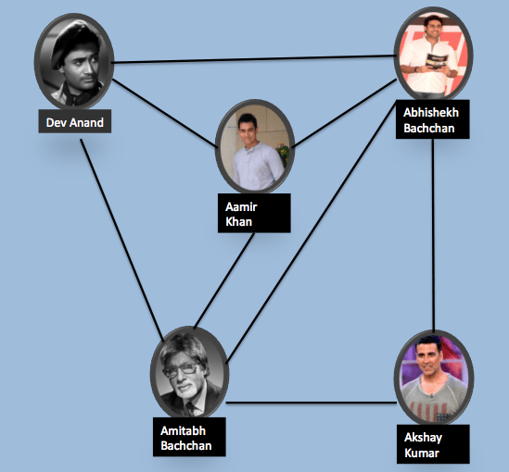
Collaboration Graph

Slide 37
Who-talks-to-Whom Graphs
Also called "Communication" Networks.
Microsoft IM (Instant Messenger) graph captures snapshot of a group of users in several billion conversations in a time period.
The edges between two nodes of the graph A and B indicate A "talked-to" B in this time period.
E-mail communication networks with edges representing communication between the entities.
Enron email communication network; Nodes of the network are email addresses and if an address i sent at least one email to address j, undirected edge from i to j.
Call graphs - node is a phone number, edge between two if engaged in a phone call over a given observation period.

Slide 38
Information Linkage Graphs
Snapshots of the Web; nodes are Web pages and directed edges represent links from between pages.
Berkeley-Stanford web graph –Nodes pages from berkeley.edu and stanford.edu domains and directed edges – hyperlinks between them.
Product co- purchasing networks ( nodes are products and edges link commonly co-purchased products)
Internet networks
Road networks
Location-based online social networks,
Wikipedia
Online communities like Reddit and Flickr

Slide 39
Heterogenous Social Networks
Different types of entities (multi-mode network) and relationships (multirelational network).
Co-purchasing network -product nodes and customer nodes. Edges may exist if a customer purchases a product.
In Amazon it is reasonable existence of distributor information to add a third type of node.
Edges between customer and a product, a product sold by a distributor, and also a customer and a distributor. Different customers could buy the same product from different distributors.
Movies dataset UCI eight different node types, actor, movie, role, studio, distributor, genre, award and country and links between them.
k-partite graph - k is the number of different node types.
k-partite graph consists of k disjoint sets of nodes, with no edges between nodes of the same set.
One special graph is a bi-partite graph where k=2.

Slide 40
A tripartite Social Graph
X1
X2
X3
A
P1
B
C
P2

Slide 41
Social Community
A real-world community is a body of individuals with common economic, social, or political interests/characteristics, often living in relative proximity.

Slide 42
Social Media Communities
A basic community comes to existence when likeminded users on social media form a link and start interacting with each other.
Any formation of a community requires
1) a set of at least two nodes sharing some interest and
2) interactions with respect to that interest.
Two types of groups in social media
Explicit Groups: formed by user subscriptions
Implicit Groups: implicitly formed by social interactions
(individuals calling Canada from the United States) -> the phone operator considers them one community for marketing purposes
We may see group, cluster, cohesive subgroup, or module in different contexts instead of “community”

Slide 43
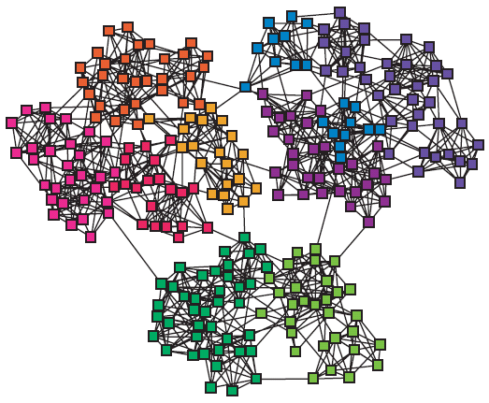
Networks & Communities
We often think of networks being organized into modules, cluster, communities:

Slide 44
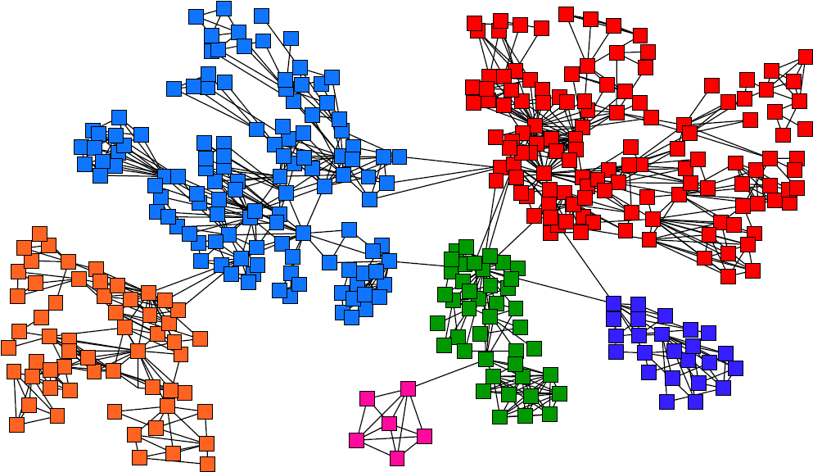
Goal: Find Densely Linked Clusters

Slide 45
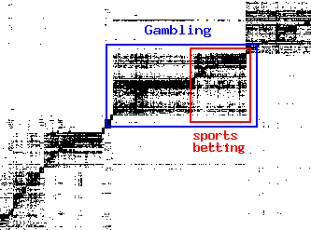
Micro-Markets in Sponsored Search
Find micro-markets by partitioning the query-to-advertiser graph:
query
advertiser

Slide 46
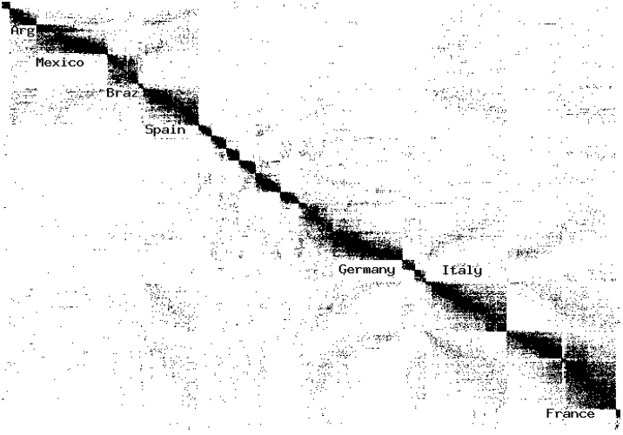
Movies and Actors
Clusters in Movies-to-Actors graph:

Slide 47
Explicit Social Media Communities
Facebook
Facebook has groups and communities. In both, users can post messages and images, can comment on other messages, can like posts, and can view activities of other users
Instagram
Group Profile and share Stories, Feed posts, or Reels with group members, so people can connect with others over their interests in a dedicated space.
Twitter
Communities form as lists. Users join lists to receive information in the form of tweets
LinkedIn
LinkedIn provides Groups and Associations. Users can join professional groups where they can post and share information related to the group

Slide 48
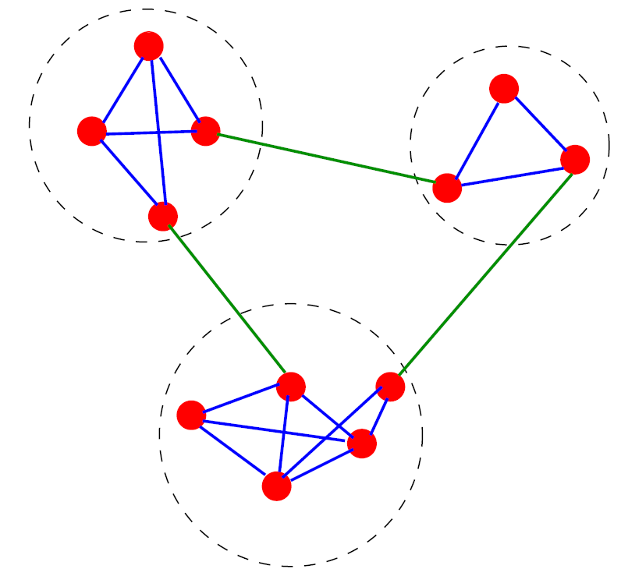
Communities: An Example
A simple graph with three communities, enclosed by the dashed circles

Slide 49
Definition
Community Detection is the process of finding clusters (‘‘communities’’) of nodes with strong internal connections and weak connections between different clusters
An ideal decomposition of a large graph is into completely disjoint communities (groups of particles) where there are no interactions between different communities.
In practice, the task is to find a partition into communities which are maximally decoupled.

Slide 50
Why Community Detection?
A community can be considered as a summary of a group of nodes in the whole network, thus easy to visualize and understand.
Sometimes, a community can reveal some properties without releasing the individuals’ privacy information.
Useful for Target Marketing, Social recommendations

Slide 51
Community Detection vs. Clustering
Most clustering algorithms can be used for community detection
In general the difference is in having link information
Clustering algorithms works on the distance or similarity matrix
k-means
Network data tends to be “discrete”, leading to algorithms using the graph property directly
k-clique, quasi-clique, vertex-betweenness, edge-betweenness etc.
Graph clustering algorithms are more proper than traditional clustering algorithms

Slide 52
Divisive Hierarchical Clustering
Divisive clustering
Partition nodes into several sets
Each set is further divided into smaller ones
Network-centric partition can be applied for the partition
Girvan-Newman Example: recursively remove the “weakest” links within a “community” to be found
Find the edge with the weakest link
Remove the edge and update the corresponding strength of each edge
Recursively apply the above two steps until a network is discomposed into a desired number of connected components.
Each component forms a community

Slide 53
Edge Betweenness
To determine weakest links, (vital links) algorithm uses a measure “edge betweenness”
Edge betweenness is the number of shortest paths that pass along with the edge
"For an edge e in a graph, edge betweenness of e is defined as the number of shortest paths between all node pairs (v_{i}, v_{j}) in the graph such that the shortest path between v_{i} and v_{j} passes through e".
If there are k different shortest paths between v_{i} and v_{j} we divide the number by 'k'.

Slide 54
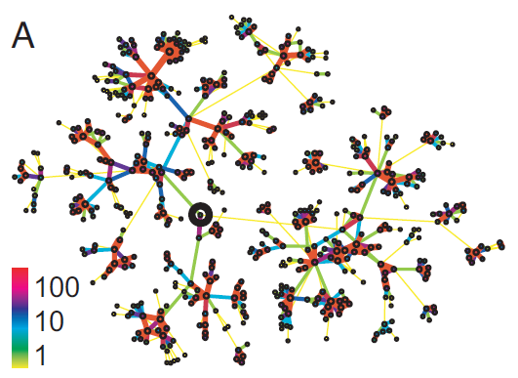
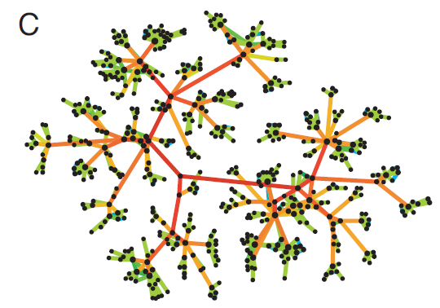
Method 1: Strength of Weak Ties
Edge betweenness: Number of shortest paths passing over the edge
b=16
b=7.5
Edge strengths (call volume) in a real network
Edge betweenness in a real network

Slide 55
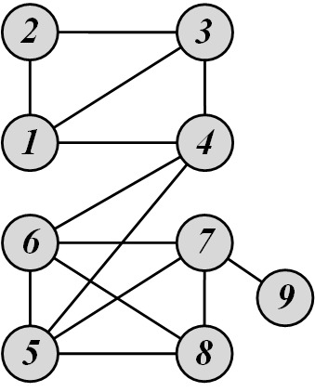
Edge Betweenness: Example
edge betweenness of e(1, 2) is 6/2 + 1 = 4, as all the shortest paths from 2 to {4, 5, 6, 7, 8, 9} have to either pass e(1, 2) or e(2, 3), and e(1,2) is the shortest path between 1 and 2

Slide 56
Edge Betweennesss
The edge betweenness centrality (EBC) can be defined as the number of shortest paths that pass through an edge in a network.
Each and every edge is given an EBC score based on the shortest paths among all the nodes in the graph.

Slide 57
The Girvan-Newman Algorithm
Calculate edge betweenness for all edges in the graph.
Remove the edge with the highest betweenness.
Recalculate betweenness for all edges affected by the edge removal.
Repeat until all edges are removed.

Slide 58
The Girvan-Newman Algorithm
Calculate (EB) score for all edges in the graph. We can store it in a distance matrix as usual.
Identify edge with highest EB score and remove it.
If several edges with the same high EB score, all of them can be removed in one step.
If this causes the graph to separate into disconnected subgraphs, these form first level communities.
Recompute the EB score for all the remaining edges.
Repeat from step 2.
Continue until the graph is partitioned into as many communities as desired or the highest EB score is below a pre defined threshold value.

Slide 59
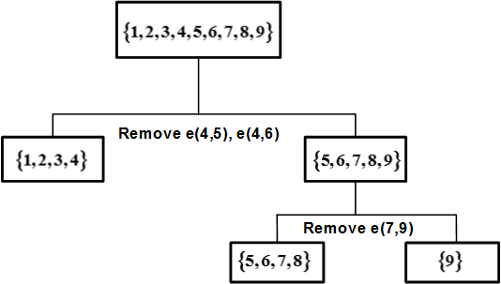
Edge Betweenness Clustering: Example
Initial betweenness value
the first edge that needs to be removed is e(4, 5) (or e(4, 6))
By removing e(4, 5), we compute the edge betweenness once again; this time, e(4, 6) has the highest betweenness value: 20.
This is because all shortest paths between nodes {1,2,3,4} to nodes {5,6,7,8,9} must pass e(4, 6);
therefore, it has betweenness 4*5 = 20.

Slide 60
Implementation
The major cost for the above algorithm is finding the EB score for every edge in the graph.
We need to find the number of shortest paths from all nodes.
Girvan and Newman proposed a faster algorithm based on use of Breadth First Search (BFS) algorithm.
For each node N in the graph
Perform breadth-first search of graph starting at node N
Determine the number of shortest paths from N to every other node
Based on these numbers, determine the amount of flow from N to all other nodes that use each edge
Divide sum of flow of all edges by 2

Slide 61
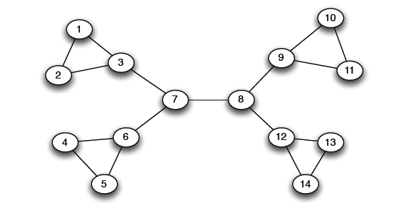
Girvan Newman method: Example
Betweenness(7-8)= 7x7 = 49
Betweenness(1-3) = 1X12=12
Betweenness(3-7)=betweenness(6-7)=betweenness(8-9) = betweenness(8-12)= 3X11=33

Slide 62
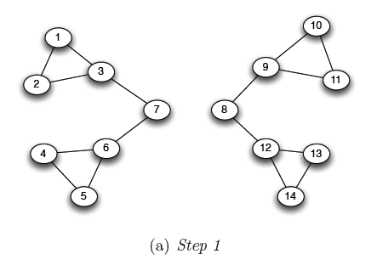
Girvan Newman method: example
Betweenness(1-3) = 1X5=5
Betweenness(3-7)=betweenness(6-7)=betweenness(8-9) =
betweenness(8-12)= 3X4=12

Slide 63
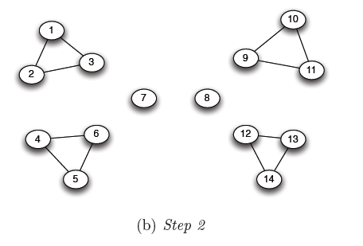
Girvan Newman method: example
Betweenness of every edge = 1

Slide 64
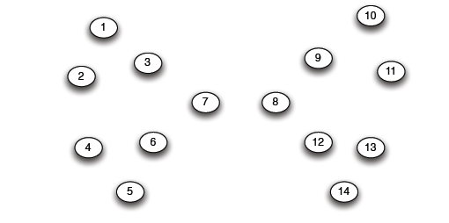
Girvan Newman method: example

Slide 65
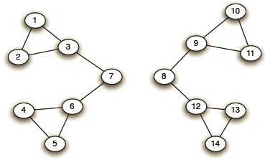
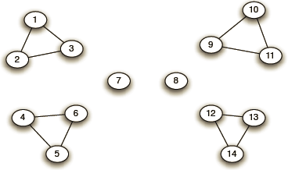
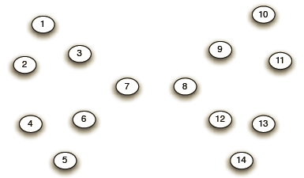
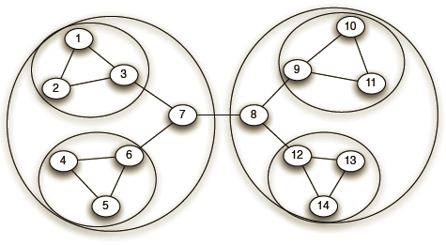
Girvan-Newman: Example
Step 1:
Step 2:
Step 3:
Hierarchical network decomposition:

Slide 66
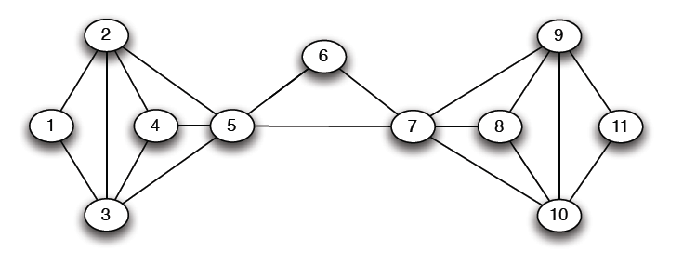
Another example
5X5=25

Slide 67
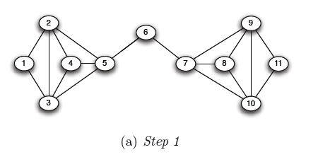
Another example
5X6=30
5X6=30

Slide 68
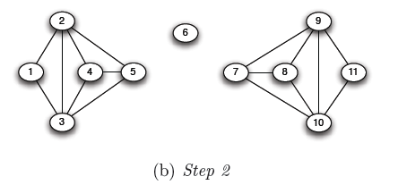
Another example

Slide 69
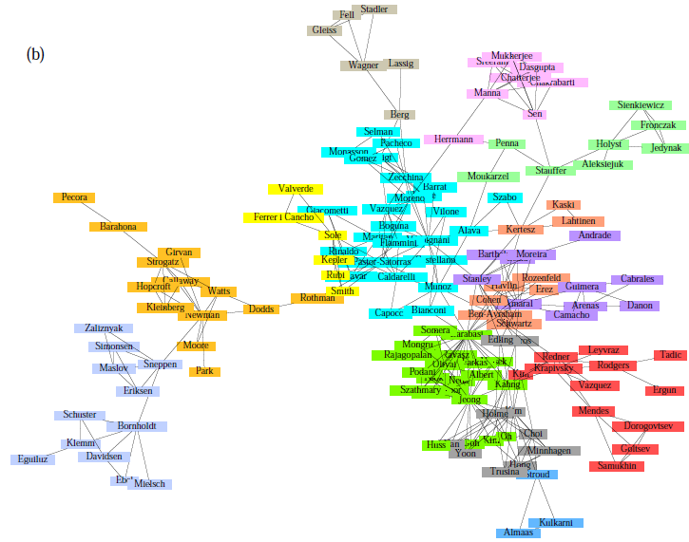
Girvan-Newman: Results
Communities in physics collaborations

Slide 70
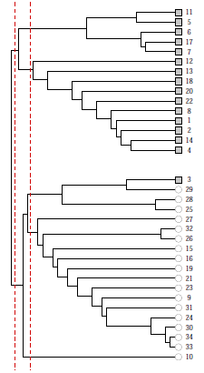
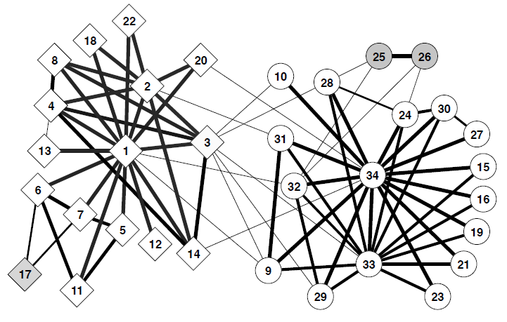
Girvan-Newman: Results
Zachary’s Karate club: Hierarchical decomposition

Slide 71
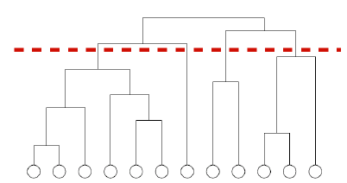
We need to resolve 2 questions
How to compute betweenness?
How to select the number of clusters?

Slide 72
Direct Discovery of Communities
Concept of overlapping communities.
In the social network arena where nodes are individuals it is natural that the individuals can belong to several different communities at a time and thus overlapping communities would be more natural.
In a Twitter network we can have individuals following several other individuals at the same time and thus participating in several communities simultaneously.

Slide 73
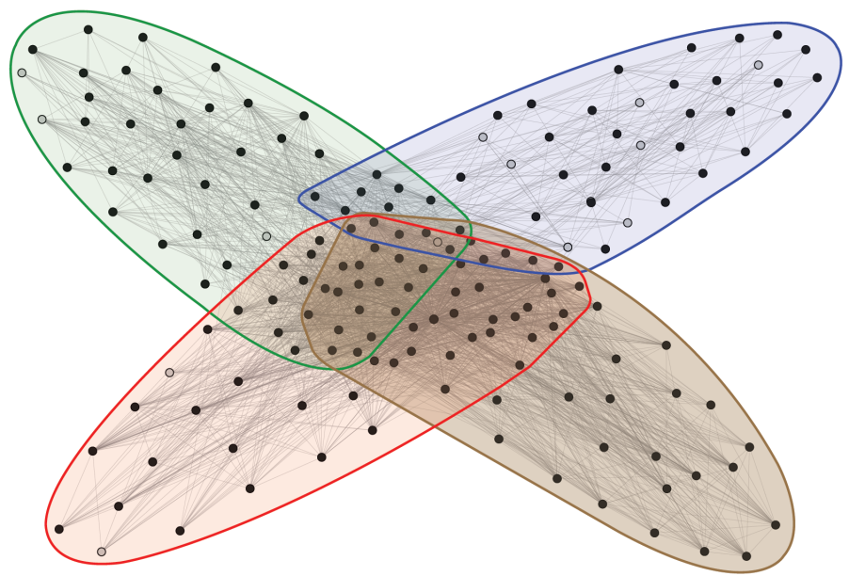
Facebook Network
Social communities
High school
Summer internship
Stanford (Basketball)
Stanford (Squash)
Nodes: Facebook Users
Edges: Friendships

Slide 74
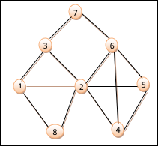
Clique Percolation Method
"Clique" a fully connected subgraph.
Every pair of vertices in the subgraph is connected through an edge.
Finding all cliques of a given size in a graph, is an NP-hard problem.
"k-clique" indicates, the clique consisting of k vertices.
For e.g. a 6-clique indicate a complete sub-graphs having 6 vertices.
six 3-cliques
(1, 2, 3), (1, 2, 8), (2, 4, 5), (2, 4, 6), (2, 5, 6) (4, 5, 6)
one 4-clique (2, 4, 5, 6).

Slide 75
Clique Percolation Method (CPM)
Identify overlapping communities.
intuition -"In a dense community likely to find large number of edges & thus cliques; Unlikely that edges between communities i.e., inter-community edges form cliques".
Assumption that community is normally formed from overlapping cliques; detects communities by searching for adjacent cliques.
First extract all the k-cliques in the network.
A new graph called as "Clique-Graph" is constructed
Each extracted K-Clique is compressed as one vertex.
Connect two vertices in this clique- graph if the cliques represented by them have (k − 1) members in common.
Each connected subgraph in the clique-graph represents one community

Slide 76
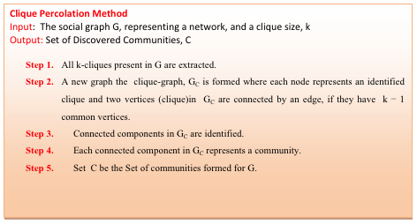

Slide 77
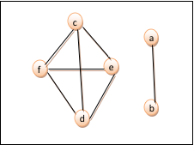
CPM - Illustrated
we have six 3-cliques.
We form a Clique-graph with 6 vertices, each vertex representing one of these following 6 cliques:
a:(1, 2, 3); b:(1, 2, 8); c:(2, 4, 5); d:(2, 4, 6); e:(2, 5, 6); f:(4, 5,6);

Slide 78
CPM - Illustrated
k = 3; add edge if two cliques share min of 2 vertices.
Clique a & Clique b have vertices 1 and 2 in common so will be connected through an edge.
Similarly add other edges
Connected components (a, b) & (c, d, e, f) form the communities.
2 connected components - 2 communities:
c1 : (1, 2, 3, 8)
c2 : (2, 4, 5, 6)
Thus the community set C = {c1, c2} where the vertex 2 overlaps both the communities.
Vertex 7 is isolated as it is not a part of any 3-cliques.

Slide 79
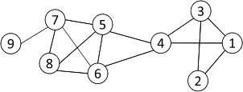
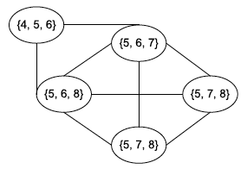
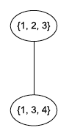
CPM Example
Cliques of size 3:
{1, 2, 3}, {1, 3, 4}, {4, 5, 6}, {5, 6, 7}, {5, 6, 8}, {5, 7, 8},
{6, 7, 8}
Communities:
{1, 2, 3, 4}
{4, 5, 6, 7, 8}
79

